Slide 1



CSA11 - OBJECT ORIENTED ANALYSIS AND DESIGN
SDLC Phases in Object-Oriented Development
PRESENTED BY:
N.Nesarajan (192511386)

Slide 2
INTRODUCTION
Software Development Life Cycle (SDLC) is a structured process used to develop high-quality software.
It helps developers plan, design, build, test, and maintain software efficiently.
Object-Oriented Development (OOD) is a software development approach based on objects and classes.
SDLC combined with object-oriented principles improves software quality, flexibility, and maintainability.
The main phases are Requirement Analysis, Design, Implementation, Testing, Deployment, and Maintenance.

Slide 3
PROBLEM STATEMENT
A hospital uses a manual system to manage patient records, appointments, and billing.
As the number of patients increases, records are misplaced, appointment schedules overlap, and billing errors occur.
These issues reduce efficiency and affect patient care.
Using SDLC and Object-Oriented Development helps build a reliable hospital management system with well-organized modules for patients, doctors, appointments, and billing.

Slide 4
CHALLENGES
Requires careful planning.
Initial design takes more time.
Complex for beginners.
Larger memory usage.
Skilled developers are needed.
Testing large projects can be time-consuming.

Slide 5
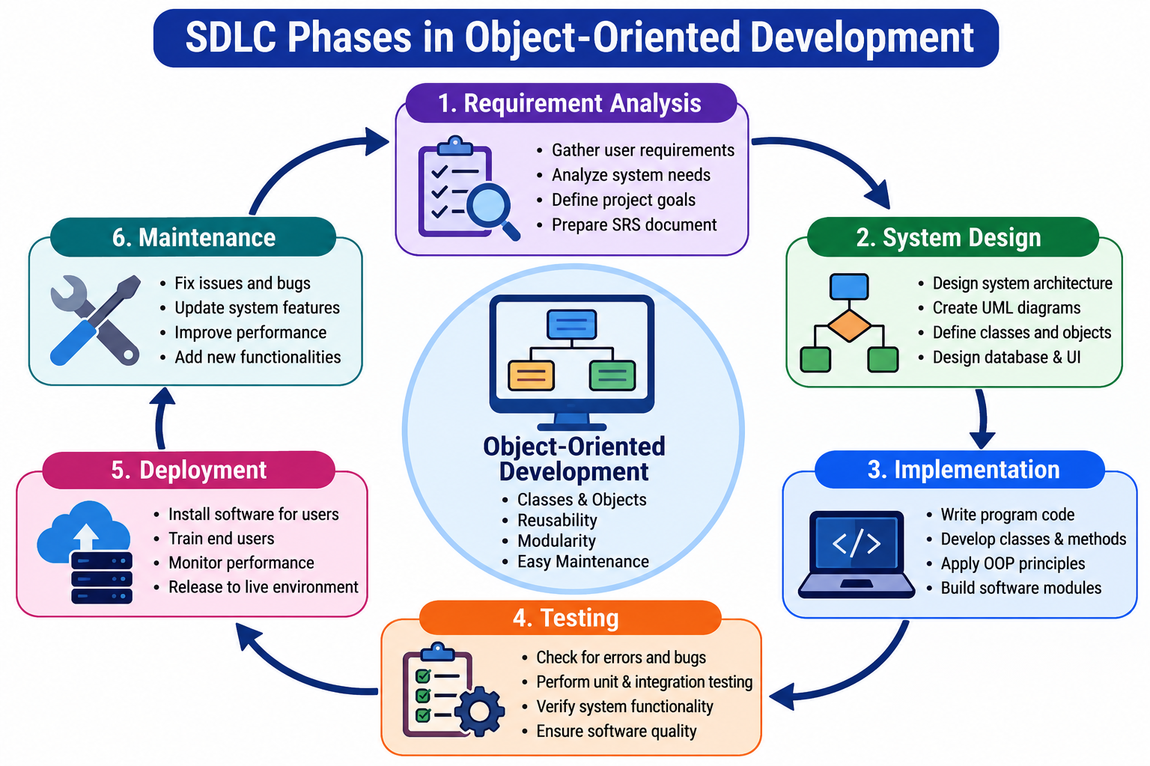
SDLC FLOW

Slide 6
REAL-WORLD APPLICATIONS
Banking Management Systems
E-Commerce Applications
Hospital Management Systems
School & College Management Systems
Mobile Applications
Online Reservation Systems
Enterprise Software
Game Development

Slide 7
CONCLUSION
SDLC provides a systematic approach to software development.
Object-Oriented Development improves software design by using classes and objects.
Every SDLC phase contributes to building reliable and efficient software.
Proper planning, design, coding, testing, and maintenance reduce development risks.
Combining SDLC with object-oriented principles results in high-quality, scalable, and maintainable software systems.

Slide 8
REFERENCES
Pressman, R. S., & Maxim, B. R. (2020). Software Engineering: A Practitioner's Approach (9th ed.). McGraw-Hill.
Sommerville, I. (2016). Software Engineering (10th ed.). Pearson Education.
Booch, G., Rumbaugh, J., & Jacobson, I. (2005). The Unified Modeling Language User Guide (2nd ed.). Addison-Wesley.
Larman, C. (2004). Applying UML and Patterns: An Introduction to Object-Oriented Analysis and Design and Iterative Development (3rd ed.). Prentice Hall.
Martin, R. C. (2008). Clean Code: A Handbook of Agile Software Craftsmanship. Prentice Hall.
Gamma, E., Helm, R., Johnson, R., & Vlissides, J. (1994). Design Patterns: Elements of Reusable Object-Oriented Software. Addison-Wesley.
Oracle Java Documentation
Microsoft Learn – Software Development Documentation
IBM Developer Documentation
GeeksforGeeks – SDLC and Object-Oriented Programming Tutorials

